Slide 1

Teach Botak-Bot
to Think
Algorithms, Data Structures and Connectionist AI
13
missions
18
class activities
95
Test Bank questions
Team B.O.T.A.K. · Foundations of CS & AI
Module: Algorithms, Data Structures & Connectionist AI
PPT Slides V1.0 · Stage 2 · November 2026
Nicky Wijaya Suhendra · Devon Reinhart · Darren Tan Siswanto · Neil Edric · Novan Ertanto Vijaya · Glen Randy Erlanda
Notes:
Purpose of this deck: a classroom course for complete beginners that follows the B.O.T.A.K. Study Guide V1.0 (Robot Edition): 13 missions, that is Missions 1–12 plus the final mission, in three parts and a finale. Suggested timing: Opening 5 min · Part 1 Algorithms (Missions 1–4) 50 min · Part 2 Data structures (Missions 5–7) 25 min · Part 3 Connectionist AI (Missions 8–12) 50 min · Final mission and closing 15 min. These totals add up the minutes given in each slide's notes. Each part can be taught as a separate session; each one opens with a divider slide and ends with a recap and next steps.
How the deck works:
- Purple slides with a gold title and Botak-Bot on a gold platform are "your turn" activities. Read the instructions, give the thinking time shown on the yellow chip, then click "Show answer".
- Teal slides with a teal title and Botak-Bot on a cyan platform are answers and debriefs.
- Interactive in slideshow mode: "Show answer" on each activity that has an answer slide jumps to it and "Back to the question" returns; "Mission route" (bottom right) opens slide 4, where every mission and part can be clicked; the rows on each part divider jump to their missions. Eleven diagrams are the animated SVGs from our repository (Assets/.../Animated), embedded as short videos that play on the next click (or click the video itself).
- Click builds: answer slides reveal one step per click (BFS maze waves on "BFS explores in waves", Dijkstra rounds, bubble-sort passes, the recursion stack, AND-gate rows, Q-update steps).
- Vote buttons: on vote slides, tap an answer button in Slide Show to pop a green ✓ or red ✗ on it, in any order.
- Navy circuit slides teach new ideas. The hexagon badge before each title names the Study Guide mission (M1–M12, F = final mission); the bar at the bottom shows progress through the 13 missions in the part colours: teal = algorithms, amber = data structures, violet = connectionist AI, coral = final mission.
- Every example comes from the B.O.T.A.K. Study Guide V1.0 and the Markdown files in the GitHub repository (Content/Markdown), so learners meet the same scores, maze, café and robot in every resource. Test Bank numbers in the notes (A = true/false, B = multiple choice, C = open-ended) are those of the submitted Test Bank V1.0: 40 + 42 + 13 = 95 questions.
- Everything plays inside this deck; no slide depends on a web page or an extra file. Where the Study Guide's labs use an online tool (TensorFlow Playground in Lab 8B, VisuAlgo), the diagram on the slide is the offline fallback.

Slide 2
“Find the highest score.”
★
72
85
40
29
100
91
Botak-Bot holds six exam score cards.
It does nothing. Why?
Tell your neighbour one reason · 20 s
Show answer →
Mission route
Notes:
Opening hook (2 min). Cut to the chase: no introductions yet.
Say: "This is Botak-Bot. It follows instructions exactly, even silly ones. I gave it six exam score cards and said: find the highest score. It did nothing."
Ask: "Why did it do nothing? Turn to your neighbour and give one reason. You have 20 seconds."
Expected answers: it doesn't know HOW; there are no steps; "find" isn't something it can do; it doesn't know where to start or when to stop.
Do not give the answer yet; take 2–3 answers from the room, then go to the next slide.
Study Guide link: Mission 1, "The problem".

Slide 3
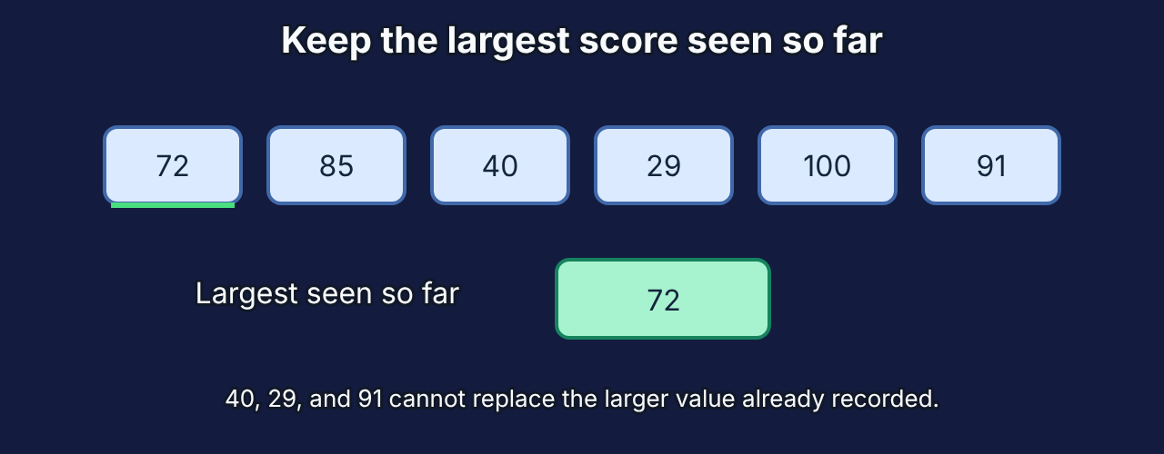
A robot needs steps, not goals
★
Steps
Goal
“Find the highest score.”
Says WHAT you want.
Botak-Bot cannot act on it.
Take the first card: highest = 72
Look at the next card
Bigger than highest? Then remember it
Repeat until no cards are left
Report highest: 100
▶ Plays on your next click Repository animation: running-maximum.svg
← Back to the question
Mission route
Notes:
Debrief (2 min).
Say: "Find the highest is a GOAL. Botak-Bot needs STEPS: where to start, what to compare, what to remember, when to stop."
Walk through the five steps on the right while pointing at the cards: start with 72 as highest; look at 85: bigger, so remember 85; 40 and 29 no; 100 yes; 91 no; report 100.
Key point: that list of steps is an algorithm. Today Botak-Bot will learn three things: how to think in steps (algorithms), how to store what it knows (data structures), and how to learn when nobody can write the steps (connectionist AI).
Transition: "Here is the route."

Slide 4
The route: 13 missions in four parts
★
Part 1 · Algorithms
Part 2 · Data structures
Part 3 · Connectionist AI
Final mission
150 min of Study Guide work
80 min of Study Guide work
210 min of Study Guide work
20 min of Study Guide work
M1
What is an algorithm?
M5
Store it smart
M8
Teach a neuron
F
Which tools fit which job?
M2
Sort the scores
M6
Stacks, queues and recursion
M9
Go deep
M3
Find it fast
M7
Trees and graphs
M10
Forecast the café
M4
Escape the maze
M11
Learn on the fly
M12
Learn from rewards
Test Bank V1.0: 40 true/false · 42 multiple choice · 13 open-ended questions, each labelled with its mission.
Notes:
Roadmap (1 min). Keep this brief.
Part 1 Algorithms: how to think step by step, and how to tell a fast method from a slow one (Study Guide Missions 1–4).
Part 2 Data structures: how to store information so the steps are quick (Missions 5–7).
Part 3 Connectionist AI: how to learn from examples when nobody can write the rules (Missions 8–12).
Finale: the Study Guide's final mission, "Which tools fit which job?", which brings all three areas together (Lab 13, Botak-Bot's job interview).
That makes the Study Guide's 13 missions: Missions 1–12 plus the final mission (F).
The minutes are the Study Guide's mission-map estimate for working through each mission alone, labs included; the class session is shorter.

Slide 5
By the end you can…
★
1
Trace an algorithm step by step and compare its cost with Big-O
2
Choose a data structure for a job and justify it
3
Calculate what one artificial neuron does and how it learns
4
Explain how forecasts, recommenders and rewards let AI learn
5
Pick the right tool from all three areas for a new job
Mission route
Notes:
Learning goals (1 min). Read them quickly; they condense the Study Guide's "What you will be able to do" list (one goal per mission there) into five, and goal 5 is the final mission.
Tell learners each goal returns at the end: the final job-interview activity tests all five.

Slide 6

Part 1 · Algorithms
Thinking step by step · about 50 minutes in class
1
What is an algorithm?
20 min
A1–3 · B1–2
2
Sort the scores
50 min
A4–10 · B3–6 · C1–2
3
Find it fast
25 min
A11–13 · B7–10 · C1, 3
4
Escape the maze
55 min
A14–17 · B11–15 · C4–5
Study Guide time per mission · Test Bank questions (A true/false, B multiple choice, C open-ended)
Mission route
Notes:
Part 1 takes about 50 minutes: what an algorithm is, sorting, searching and Big-O, and finding routes through a maze.
Study Guide: Missions 1–4. Test Bank: A1–A17, B1–B15, C1–C5.

Slide 7
What makes it an algorithm?
M1
Input
Works on zero or more given values
Output
Produces a definite result
Definiteness
Every step is clear and unambiguous
Finiteness
Stops after a finite number of steps
Algorithm = the method. Program = the method written in a language such as Python.
Properties as in Study Guide §1.1; see also Shaffer (2010, pp. 18–19)
Mission route
Notes:
Definition (3 min).
Say: "An algorithm is a finite sequence of precise instructions that solves a problem or completes a task." (Study Guide §1.1.) Then use the four property cards, the ones in the Study Guide's table. For each one, ask how our highest-score steps pass the test: input = the cards; output = 100; definiteness = every step is exact; finiteness = stops after the last card.
Extra point, not in the guide's table: Shaffer (2010, pp. 18–19) also asks that an algorithm be correct, giving the right answer for every valid input. Our highest-score steps are.
Algorithm vs program: the algorithm is the method; a program is that method written in one language, such as Python. Same algorithm, many programs.
Important limit (a classroom extra, not in the Study Guide): an operating system is meant to keep running, so it does not meet "finite" (Shaffer, 2010, p. 19); Hill (2016, p. 15) argues a cooking recipe is not strictly an algorithm because it can be followed "well or badly".
Source: Shaffer (2010, pp. 18–19). Study Guide §1.1 "Definition".

Slide 8
Is “Sort these numbers” an algorithm?
M1
Hands up:
✗
✓
YES
NO
Tap an answer to check it
Use the four properties from the last slide to justify your vote.
Vote + one reason · 30 s
Show answer →
Mission route
Notes:
Activity (1 min). Hands up for YES, then for NO. Count roughly and say the split out loud.
Then ask one person from each side for a reason. Do not confirm yet.
Expected answer on the next slide: NO.

Slide 9
No: it states a goal, not steps
M1
“Sort these numbers”
Which two numbers first?
What after comparing?
When do I stop?
Fails: definiteness
A robot cannot follow it without guessing. An algorithm must say exactly what to do next.
Next: three ways to give exact sorting steps.
← Back to the question
Mission route
Notes:
Debrief (1 min).
It fails DEFINITENESS: Botak-Bot cannot tell which two numbers to compare or what to do after comparing them. Compare with bubble sort on the next slide, which gives exact steps.
Common misconception: "anything a computer does is an algorithm". The steps must be precise enough for a machine that does exactly what it is told.
Study Guide: Checkpoint 1. Test Bank: A1–A3, B1–B2.

Slide 10
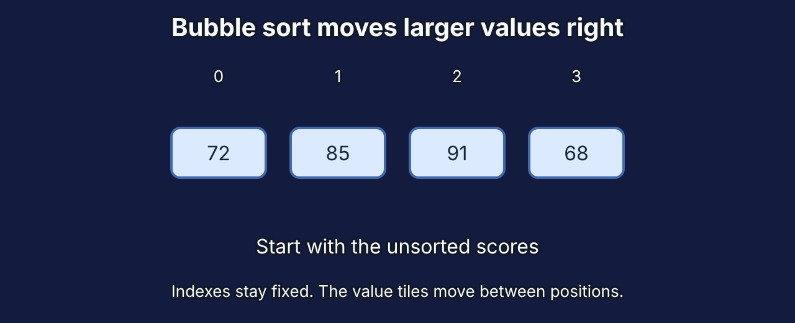
Bubble sort: each pass parks the biggest value
M2
Start
72
85
91
68
Pass 1
72
85
68
91
Pass 2
72
68
85
91
▶ Plays on your next click Repository animation: bubble-sort.svg
Compare neighbours left to right; swap if the left one is bigger. Stop after a pass with no swaps.
Pass 3
68
72
85
91
Example from Content/Markdown/1_Algorithm/02 basic sorting algorithms.md; teal cells are in their final place
Mission route
Notes:
Show, not tell (3 min). Example from our Markdown: [72, 85, 91, 68].
Pass 1 compares neighbours left to right: 72>85? no; 85>91? no; 91>68? yes, swap. Now 91 is in its final place (teal).
Pass 2 does the same on the unsorted part: 85>68 swaps, so 85 is parked. Pass 3: 72>68 swaps. Sorted.
Point at the teal cells growing from the right: that is the "bubbling".
Early exit: if a pass makes no swaps, the list is sorted and we stop. Note: Shaffer's version has no early exit, so check which version a source means. The Study Guide (Mission 2) and our Markdown use the early-exit version.
Optional demo: VisuAlgo sorting (visualgo.net/en/sorting), listed in the Study Guide's learning resources for Mission 2; needs internet. Offline: the animation on this slide is the fallback.

Slide 11
Predict: bubble sort on [3, 1, 2]
M2
3
1
2
Bubble sort with early exit. How many…
passes? comparisons? swaps?
Trace it on paper · 60 s
Show answer →
Mission route
Notes:
Activity (2 min). Learners trace on paper or in their heads.
Ask for three numbers: passes, comparisons, swaps (with early exit).
Give 60 seconds, then take answers by hand: "Who got 2 passes?" "3 passes?"
Answer on the next slide.
Study Guide: Checkpoint 2.

Slide 12
2 passes, 3 comparisons, 2 swaps
M2
Pass 1
3 > 1 swap · 3 > 2 swap
1
2
3
Pass 2
1 > 2? no · no swaps → stop
1
2
3
Why pass 2? A pass with no swaps is the only way to know it is sorted.
← Back to the question
Mission route
Notes:
Debrief (1 min).
Pass 1: 3>1 swap → [1, 3, 2]; 3>2 swap → [1, 2, 3]. Two comparisons, two swaps.
Pass 2: 1>2? no. One comparison, no swaps → early exit.
Total: 2 passes, 3 comparisons, 2 swaps.
Common mistake: forgetting pass 2. The robot cannot "see" the list is sorted; it needs a pass with no swaps to know.

Slide 13
Three sorts, three strategies
M2
 | Strategy | Sorted list | Reverse order | Swaps
Bubble | Swap out-of-order neighbours | n − 1 comparisons* | n(n − 1)/2 | Many
Selection | Pick the smallest, put it next | n(n − 1)/2 | n(n − 1)/2 | At most n − 1
Insertion | Slide each item into place | n − 1 comparisons | n(n − 1)/2 | Many shifts
* with the early exit used in our guide
All three: O(n²) in the worst case.
Shaffer (2010, pp. 238–243)
Mission route
Notes:
Comparison (3 min). n = number of items.
Bubble sort swaps neighbours; selection sort scans for the smallest and swaps it into place once per pass; insertion sort slides each new item left into the sorted part, like sorting cards in your hand.
All three are O(n²) in the worst case. Best cases differ: insertion sort (and bubble sort with early exit) need only n − 1 comparisons on a sorted list; selection sort always makes n(n − 1)/2.
Selection sort makes at most n − 1 swaps, which helps when moving an item is expensive (Shaffer, 2010, p. 242).
Source: Shaffer (2010, pp. 238–243). Study Guide §2.5 "Comparing the three sorts"; Lab 2B "Sort race: selection sort vs insertion sort".

Slide 14
Which sort would you choose?
M2
A
A class list that is already almost in order: one new score has been added at the end.
B
Huge records where every move is very slow, so you want as few swaps as possible.
Discuss with a neighbour · 60 s
Show answer →
Mission route
Notes:
Neighbour discussion (2 min). Two situations; pairs choose a sort for each and give one reason.
After 60 seconds, take a hands-up vote for each situation: bubble / selection / insertion.
Answers on the next slide.

Slide 15
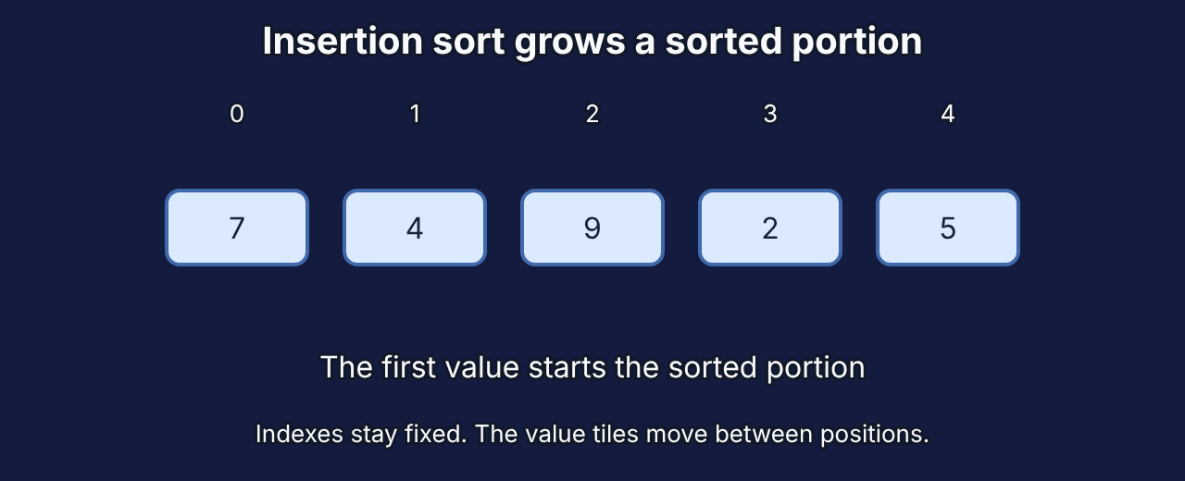
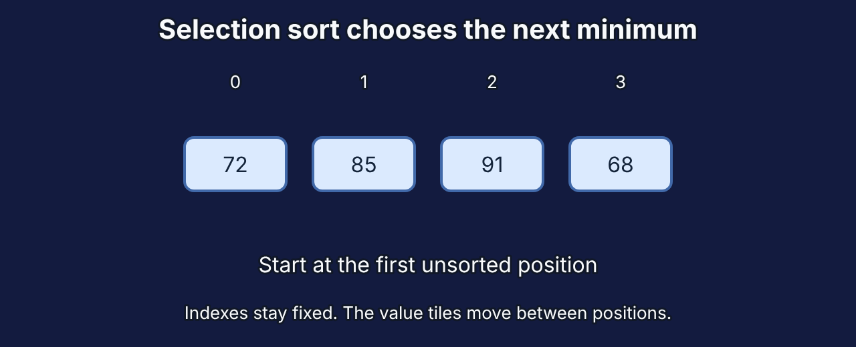
A: insertion sort · B: selection sort
M2
A · Insertion sort
Nearly sorted: each item moves only a little. About n comparisons instead of n².
B · Selection sort
At most one swap per pass: n − 1 swaps in total.
▶ Plays on your next click Repository animation: insertion-sort.svg
▶ Plays on your next click Repository animation: selection-sort.svg
Shaffer (2010, pp. 239, 242)
← Back to the question
Mission route
Notes:
Debrief (1 min).
A: insertion sort passes over the sorted part almost for free and moves the new score left only past bigger scores. Study Guide Lab 13 (d), in the final mission, uses the same idea: at most 59 comparisons for a class of 30.
B: selection sort makes at most n − 1 swaps (Shaffer, 2010, p. 242).
Misconception: "bubble sort is always slow". With early exit it is fast on an already sorted list; it is slow on most other lists.
Study Guide Checkpoint 2B. Test Bank: A4–A10, B3–B6, C1–C2.

Slide 16
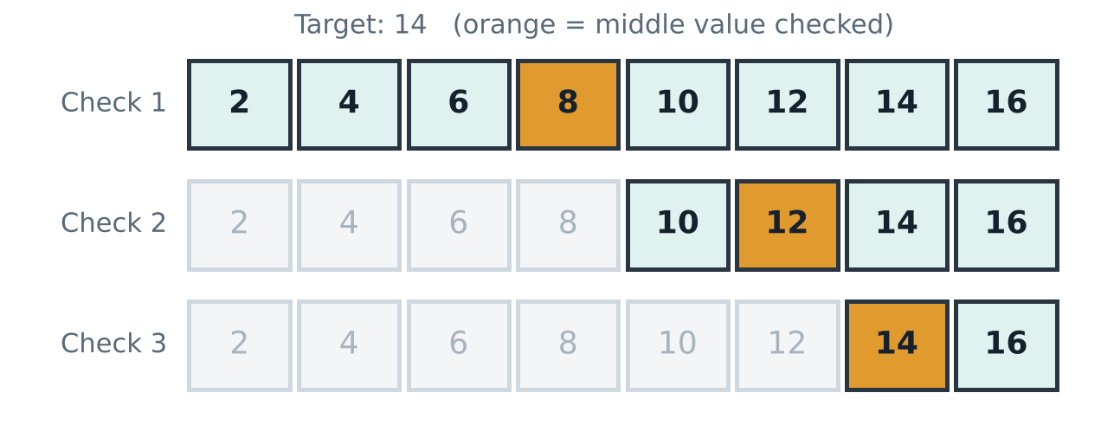
Searching: check every item, or halve the list?
M3
Linear search
Check every item: up to n checks
Binary search (sorted list)
Check the middle, drop half: 3 checks
Shaffer (2010, p. 94)
Mission route
Notes:
Show, not tell (3 min).
Linear search checks items one by one from the start: up to n checks.
Binary search needs a SORTED list: check the middle, throw away the half that cannot contain the target, repeat. Here it finds 14 in 3 checks: 8, then 12, then 14.
Ask: "What happens if the list is not sorted?" Binary search can throw away the half that contains the target and miss it.
Sources: Shaffer (2010, p. 94); Chivers & Sleightholme (2018, p. 392). Study Guide §3.1 "Linear search" and §3.2 "Binary search"; Lab 3 "Guess my number".

Slide 17
Binary search: 20 checks, not 1,000,000
M3
1,000,000
1,000,000
20
items in a sorted list
checks for linear search (worst case)
checks for binary search
Double the list to 2,000,000 items: binary search needs just one more check.
Chivers & Sleightholme (2018, p. 392)
Mission route
Notes:
Stat slide (2 min). Let the numbers land.
1,024 items can be halved only 10 times before one is left (2^10 = 1,024). A million items need about 20 halvings.
Ask: "If the list doubles to 2 million, how many more checks does binary search need?" Answer: just one more.
Source: Chivers & Sleightholme (2018, p. 392): binary search is O(log n).

Slide 18
Big-O: how the work grows
M3
Big-O | Name | Example | Double n →
O(1) | Constant | Read item 5 of an array | Same work
O(log n) | Logarithmic | Binary search | +1 step
O(n) | Linear | Linear search | × 2
O(n²) | Quadratic | Bubble, selection, insertion sort | × 4
Shaffer (2010, pp. 67–70)
Mission route
Notes:
Big-O (3 min). Big-O names how the work grows when the input grows; it ignores the speed of the computer and constant factors.
The right column is the key: what happens to the work when n doubles?
O(1): the same (reading one array cell). O(log n): one more step (binary search). O(n): double (linear search). O(n²): four times (simple sorts).
Important limit: for small inputs constants can matter (Shaffer, 2010, p. 68), and Big-O is an upper bound on growth, not a stopwatch time.
Memory follows the same idea: space complexity (next activity's follow-up; the Study Guide defines it in Mission 3).
Study Guide §3.3 "Measuring efficiency: Big-O notation".

Slide 19
An O(n²) sort: the list doubles
M3
1,000 items → 2,000 items. Roughly how much more work?
✗
✓
✗
A × 2
B × 4
C × 1,000
Tap an answer to check it
Hands up: A, B or C · 20 s
Show answer →
Mission route
Notes:
Activity (1 min). Hands up for A, B or C.
Expected: B (× 4), because (2n)² = 4n².
Answer on the next slide, together with a space-complexity follow-up.

Slide 20
B: about four times the work
M3
× 4
n doubles | Work
O(1) | Same
O(log n) | +1 step
O(n) | × 2
O(n²) | × 4
(2n)² = 4n²
Space complexity asks the same question about memory.
Shaffer (2010, pp. 84–85)
← Back to the question
Mission route
Notes:
Debrief (2 min), Study Guide Checkpoint 3.
(2n)² = 4n², so doubling n multiplies the work by about 4: 1,000 → 2,000 items means roughly 4 times the steps, not 2.
Contrast: O(n) would double, O(log n) would add just one step, O(1) would stay the same (the table on this slide). Click once to reveal the space-complexity line.
Memory follows the same idea: §3.3 also defines space complexity, how the memory needed grows with n. Mission 7 (§7.6 "Storing a graph") compares two ways to store the same friendships, an adjacency list and an adjacency matrix.
Space/time trade-off: you can often save time by using more memory, or the other way round (Shaffer, 2010, p. 85).
Test Bank: A11–A13, B7–B10, C1, C3.

Slide 21
Predict: the shortest route from S to G
M4
S
#
How many steps is the shortest route?
Move up, down, left or right. # is a wall.
#
#
#
#
✗
✗
5 steps
6 steps
#
#
#
G
✓
✗
7 steps
8 steps
Tap an answer to check it
Vote by hands · 20 s
Show answer →
Mission route
Notes:
Activity (1 min). Ask learners to guess the number of steps of the shortest route (moves up, down, left, right; # is a wall).
Take a quick vote: 5, 6, 7 or 8 steps. In Slide Show, tap a button to show ✓ or ✗ (tap 7 last, after the next slide's BFS demo if you want suspense).
Say: "A maze is a graph: each open cell is a vertex, each allowed move is an edge."
Study Guide §4.1 "Mazes are graphs" and §4.2 "Breadth-first search (BFS)"; Lab 4 "Be the BFS" (printable maze). Optional demo: VisuAlgo graph traversal (visualgo.net/en/dfsbfs) from the Study Guide's learning resources; needs internet, and the next slide is the offline version.

Slide 22
BFS explores in waves: 7 steps
M4
#
Wave 0: start at S
Wave 1: S’s open neighbours
Wave 2: one step further
Wave 3: down the corridor
Wave 4
Wave 5
Wave 6: two cells at once
Wave 7: G reached!
Wave 8: the last open cell
S
Trace back 7, 6 … 0: the route
0
0
1
1
7
8
1
2
#
#
2
6
Waves from S
0, then 1, then 2 … G is reached in wave 7.
#
3
#
3
4
4
5
5
Why it is the shortest
A queue explores near cells first, so the first arrival at G uses the fewest steps.
#
#
#
6
G
6
7
7
Click to release each wave
Shaffer (2010, p. 401)
← Back to the question
Mission route
Notes:
Debrief with demonstration (4 min).
BFS (breadth-first search) numbers S as 0, every open neighbour 1, their unnumbered neighbours 2, and so on: a ripple. It keeps waiting cells in a QUEUE (first in, first out), so near cells are always explored before far ones. The first time it reaches G is therefore by the fewest steps: 7. Trace back from G through numbers 6, 5, … 0 to get the route (orange).
Click-through demo (10 clicks): each click releases the next BFS wave (0, 1, 2 …); ask the room "which cells get the next number?" before each click. Click 8 reaches G in wave 7; click 9 fills the last cell; click 10 traces the route back from G in orange.
Source: Shaffer (2010, p. 401). Study Guide Lab 4 feedback.

Slide 23
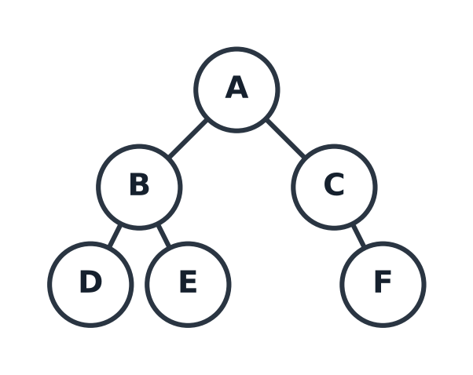
BFS or DFS: write the visiting order
M4
Start at A, left neighbours first.
BFS order: ?
DFS order: ?
BFS = queue (waves). DFS = stack (go deep, then back up).
Write both orders · 60 s
Show answer →
Mission route
Notes:
Activity (2 min). Learners write both orders starting at A, visiting left neighbours first.
BFS uses a queue (level by level). DFS uses a stack (deep first, then back up).
Give 60 seconds, then ask two volunteers to read their orders.

Slide 24
BFS: A B C D E F · DFS: A B D E C F
M4
Search | Order | Uses a | Good for
BFS | A → B → C → D → E → F | Queue | Fewest steps
DFS | A → B → D → E → C → F | Stack | Deep paths
Shaffer (2010, pp. 400–401)
← Back to the question
Mission route
Notes:
Debrief (2 min).
BFS visits level by level: A (distance 0), B and C (1), D, E and F (2).
DFS goes down one branch to the bottom (A, B, D), backs up to B for E, then back to A and down to C and F.
When to use which: fewest steps → BFS; "is there any route?" → either; follow one path to the end (puzzles with dead ends) → DFS. DFS's first route is not guaranteed to be shortest.
Source: Shaffer (2010, pp. 400–401). Study Guide §4.3 "Depth-first search (DFS)"; Checkpoint 4. Test Bank A14–A15, B11–B13, C4.

Slide 25
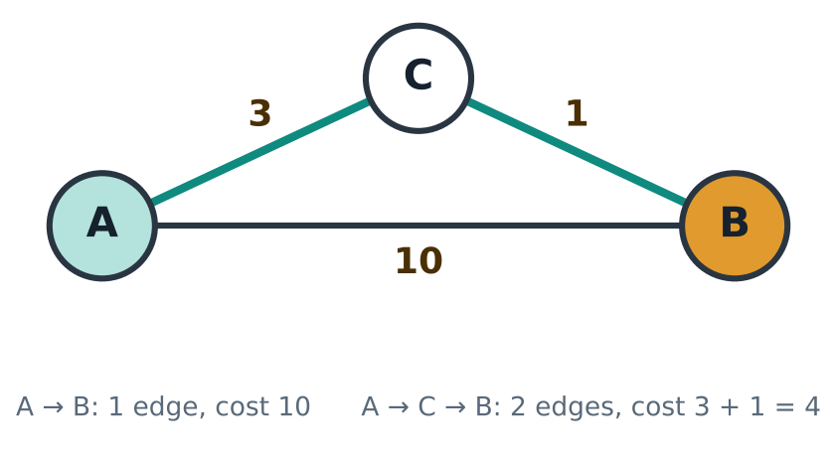
When steps cost different amounts
M4
BFS: A → B
1 edge · cost 10
Cheapest: A → C → B
2 edges · cost 4
Fewest steps is not the same as cheapest.
Mission route
Notes:
Transition to weighted graphs (2 min).
BFS counts steps, not distance. In our Markdown example, A → B directly costs 10, but A → C → B costs 3 + 1 = 4. BFS picks the 1-edge route (cost 10) because it has fewer edges.
Ask: "Which route would you take if the numbers were minutes?" Everyone picks A → C → B.
We need an algorithm that counts cost: Dijkstra's algorithm, a greedy algorithm.
Study Guide §4.4 "When steps have different costs: greedy algorithms"; Checkpoint 4B uses this example. Markdown: Content/Markdown/1_Algorithm/07 greedy algorithm and optimization.md.

Slide 26
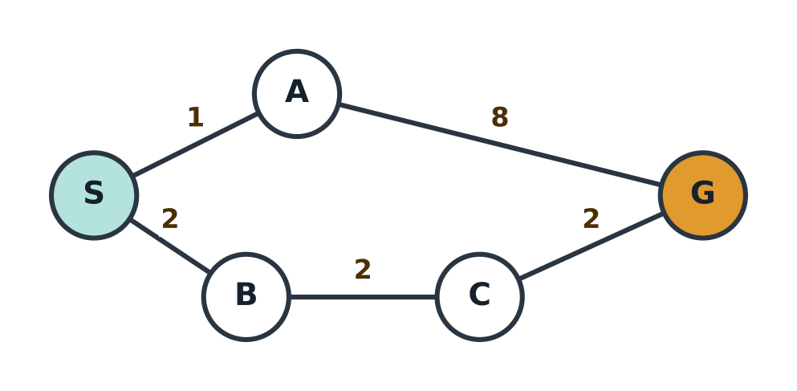
Dijkstra: always settle the cheapest total next
M4
Round
Settle
Update
1
S (0)
A = 1, B = 2
2
A (1)
G = 9
3
B (2)
C = 4
4
C (4)
G = 6 (cheaper)
Cheapest: S → B → C → G = 6
BFS route S → A → G = 9
5
G (6)
Stop
Shaffer (2010, pp. 408–409)
Mission route
Notes:
Demonstration (4 min). Each click reveals the next round (6 clicks); point at the graph each time.
Every vertex has a best-known total (∞ at first, 0 for S). Each round settles the unsettled vertex with the smallest total, then checks whether going through it makes a neighbour cheaper.
Round 1 settle S: A = 1, B = 2. Round 2 settle A: G = 9. Round 3 settle B: C = 4. Round 4 settle C: G = 6, cheaper than 9. Round 5 settle G: stop.
Cheapest route S → B → C → G costs 6; BFS would take S → A → G (fewest edges) costing 9.
Why greedy is safe here: costs are never negative, so a settled total can never be beaten later.
Source: Shaffer (2010, pp. 408–409, 529). Test Bank A16, B14, C5.

Slide 27
Greedy or not? Make 6 with coins 1, 3 and 4
M4
Greedy works here
Change for 37 with coins 1, 5, 10, 20:
20 + 10 + 5 + 1 + 1 = 5 coins, the best possible
1
3
4
Make 6. Greedy (biggest coin first) gives…?
The fewest coins possible is…?
Work it out with a neighbour · 45 s
Show answer →
Mission route
Notes:
Activity (2 min), from Study Guide Lab 4B "Greedy or not?".
A greedy algorithm makes the choice that looks best right now and never goes back. Dijkstra is greedy and correct (non-negative costs). Giving change with coins 1, 5, 10, 20 greedily is also correct: 37 = 20 + 10 + 5 + 1 + 1 (Lab 4B Part 1).
Now the only coins are 1, 3 and 4 (Lab 4B Part 2). Ask pairs: "What does the greedy rule give for 6? What is the fewest possible?" Give 45 seconds.
Expected: greedy 4 + 1 + 1 = 3 coins; best 3 + 3 = 2 coins. Answer on the next slide.
Source: Shaffer (2010, p. 529).

Slide 28
Greedy: 3 coins · Best: 3 + 3 = 2 coins
M4
Greedy
4 + 1 + 1 = 3 coins
Takes the 4 and never goes back.
Best
3 + 3 = 2 coins
The 4 looked best but blocked this.
Best now is not always best overall.
← Back to the question
Mission route
Notes:
Debrief (2 min), Lab 4B Part 2 feedback.
Clicks 1–3 reveal the greedy card, the best card and the take-away line.
Greedy takes the 4 because it looks best right now, then needs 1 + 1: 3 coins. Two 3s make 6 with 2 coins. Taking the 4 looked best but blocked the better answer, and greedy never goes back.
Lab 4B Part 3 (optional): a "greedy walker" on the S–G graph always takes the cheapest edge: S → A (1), then A → G (8) = 9, while Dijkstra finds S → B → C → G = 6. Dijkstra is greedy too, but it compares totals, so with non-negative costs it is safe.
Take-away: greedy is fast and sometimes right (coins 1, 5, 10, 20; Dijkstra), but not always. Check it before trusting it.
Test Bank A17, B15, C5.

Slide 29
Part 1 recap: think in steps
M4
Precise steps
Every step is exact, and it always stops.
Count the growth
Big-O: O(log n) beats O(n) beats O(n²).
Pick the search
BFS: fewest steps. Dijkstra: cheapest cost.
Next
Study Guide Missions 1–4: Labs 1–4B, Checkpoints 1–4B
Test Bank A1–A17, B1–B15, C1–C5
Markdown notes: Content/Markdown/1_Algorithm
Mission route
Notes:
Recap and next steps (2 min).
Three takeaways: precise steps; count how work grows; BFS for fewest steps, Dijkstra for cheapest cost.
Next steps for learners (read them out):
Study Guide Missions 1–4: Labs 1, 2, 2B, 3, 4, 4B and Checkpoints 1, 2, 2B, 3, 4, 4B.
Test Bank: A1–A17, B1–B15, C1–C5.
Markdown: Content/Markdown/1_Algorithm, chapters 01–03 and 05–07 (chapter 04, recursion, belongs to Mission 6).
Video tutorial "Sequential Decisions.mp4" (Content/Videos) goes one step beyond Mission 4: it plans choices over several days (two lunch vouchers, three meals). Treat it as an extension; it is not part of the Study Guide or the Test Bank.

Slide 30

Part 2 · Data structures
Storing what Botak-Bot knows · about 25 minutes in class
5
Store it smart
25 min
A18–19 · B16–18 · C6
6
Stacks, queues and recursion
30 min
A20–23 · B19–23 · C4
7
Trees and graphs
25 min
A24–27 · B24–27 · C7
Study Guide time per mission · Test Bank questions (A true/false, B multiple choice, C open-ended)
Mission route
Notes:
Part 2 takes about 25 minutes: arrays and linked lists (Mission 5), stacks, queues and recursion (Mission 6), trees and graphs (Mission 7).
Study Guide Missions 5–7. Test Bank: A18–A27, B16–B27, C4, C6–C7.

Slide 31
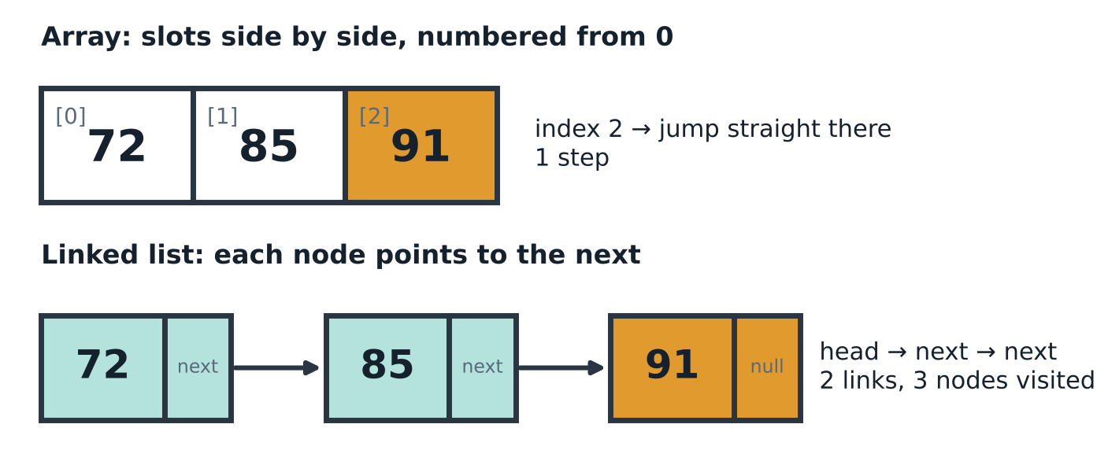
“Third score, please.”
M5
One answers instantly. One has to walk. Why?
Tell your neighbour · 20 s
Show answer →
Mission route
Notes:
Hook (1 min). Botak-Bot stores 72, 85, 91 twice: in an array and in a linked list. Asked for the third score, the array answers at once; the linked list has to walk. Why?
Ask pairs for 20 seconds. Expected: the array knows where index 2 is; the list must follow links from the head.

Slide 32
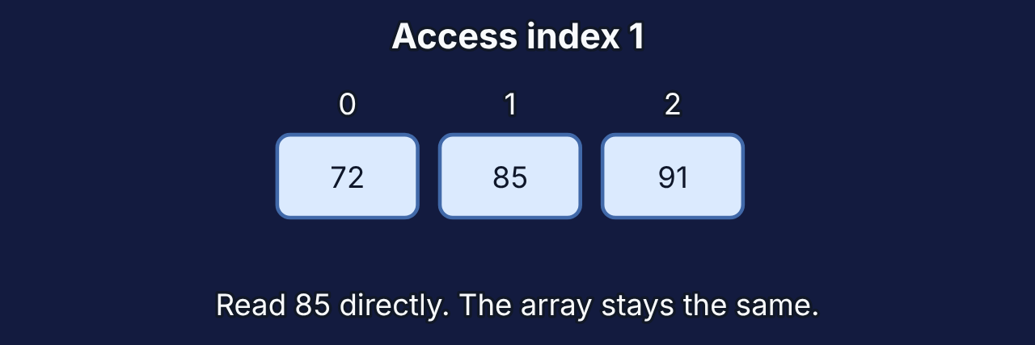
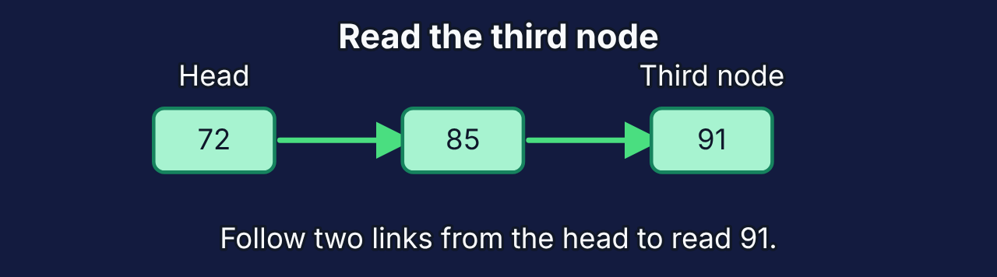
Arrays jump; linked lists follow links
M5
 | Array | Linked list
Read item k | O(1): jump straight there | O(n): follow k links
Insert in the middle | O(n): shift later items | O(1) once you are there: relink
Memory | May reserve empty slots | One extra link per item
▶ Plays on your next click Repository animation: list-access.svg
▶ Plays on your next click Repository animation: array-access.svg
Shaffer (2010, pp. 106, 113, 117–118)
← Back to the question
Mission route
Notes:
Debrief + comparison (3 min).
Array: items side by side; the computer calculates where index 2 is → O(1). Inserting in the middle shifts every later item → O(n).
Linked list: each node points to the next. Reaching position k means following k links → O(n). Once you are at a position, inserting just changes two links → O(1).
Memory: an array may reserve unused slots; a list stores one extra link per item.
Misconception: "linked lists are just worse arrays". They lose at reading by position but win at inserting where you already are.
The two animations read different positions: the array one jumps straight to index 1 (85); the list one walks from the head to the third node (91), following two links. Both show the same idea: the array calculates the position, the list has to walk.
Sources: Shaffer (2010, pp. 106, 113, 117–118). Study Guide §5.1 "Arrays" and §5.2 "Linked lists"; Lab 5 "The human linked list".

Slide 33
Choose the structure
M5
A
A leaderboard read by rank thousands of times, rarely changed.
B
A playlist where songs are often inserted right after the current song.
Hands up: array or linked list? · 30 s
Show answer →
Mission route
Notes:
Activity (1 min). Hands up for array or linked list in each case.
A: a leaderboard read by rank thousands of times, rarely changed → array (O(1) reads).
B: a playlist where songs are often inserted right after the current song → linked list (relink in O(1) at the current position).
Answers on the next slide.

Slide 34
A: array · B: linked list
M5
A · Array
Mostly reading by position: O(1) each time.
B · Linked list
Inserting where you already are: change two links, O(1).
Choose by the operation you do most.
← Back to the question
Mission route
Notes:
Debrief (1 min). The right structure depends on which operation you do most.
Study Guide Checkpoints 5 and 5B. Test Bank: A18–A19, B16–B18, C6.

Slide 35
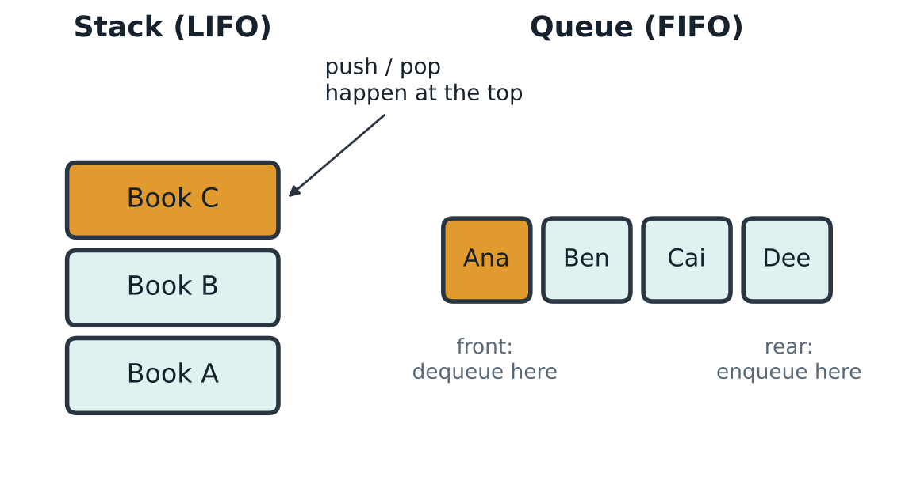
Stack: last in, first out · Queue: first in, first out
M6
Stack (LIFO)
Undo · function calls · DFS
Queue (FIFO)
Printer · waiting line · BFS
Shaffer (2010, pp. 125, 134)
Mission route
Notes:
Concept (2 min). Use real objects if you can: three books (stack) and three volunteers (queue).
Stack: push adds to the top, pop removes the top. Used for undo, function calls and DFS.
Queue: enqueue at the rear, dequeue from the front. Used for printers, waiting lines and BFS.
Sources: Shaffer (2010, pp. 125, 134). Study Guide §6.1 "Stack: last in, first out (LIFO)" and §6.2 "Queue: first in, first out (FIFO)"; Lab 6 "Book stack and bracket checker".

Slide 36
Add A, B, C, then remove one item
M6
A
B
C
Stack
removes… ?
Queue
removes… ?
added in this order
Thumbs up when you know · 20 s
Show answer →
Mission route
Notes:
Activity (1 min). Botak-Bot adds A, then B, then C to a stack AND to a queue, then removes one item from each.
Ask: "Which item comes out of the stack? Of the queue?" Thumbs up when you know.
Expected: stack → C; queue → A.
Study Guide Lab 6 Parts 1–2 practise the same moves with a book stack and a café line.

Slide 37
Stack gives C · Queue gives A
M6
A
B
C
A
B
C
Stack: last in, first out → C
Queue: first in, first out → A
Part 1 again: BFS waits in a queue (waves). DFS waits in a stack (deep first).
← Back to the question
Mission route
Notes:
Debrief and connection (2 min).
Stack: the last item in (C) comes out first. Queue: the first item in (A) comes out first.
Connect back to Part 1: BFS keeps cells in a queue, so near cells come first; DFS keeps them in a stack, so it goes deep first.
Study Guide Checkpoint 6. Test Bank: A20–A23, B19–B23, C4.

Slide 38
Recursion runs on a stack
M6
factorial(1)
base case → returns 1
top of the call stack ↑
Last call made, first to finish
Every recursive function needs a base case, or the calls never stop.
factorial(2)
waits… then 2 × 1 = 2
factorial(3)
waits… then 3 × 2 = 6
Shaffer (2010, p. 129)
Mission route
Notes:
Show, not tell (3 min). factorial(n) = n × factorial(n − 1), with base case factorial(1) = 1.
Clicks 1–3 push the calls onto the stack from the bottom: factorial(3) waits for factorial(2), which waits for factorial(1). factorial(1) is the base case and returns 1. Then the waiting calls finish in reverse order: factorial(2) returns 2 × 1 = 2, factorial(3) returns 3 × 2 = 6.
The last call made is the first to finish: last in, first out.
Ask: "What happens without the base case?" Calls never stop: a stack overflow (RecursionError in Python).
Source: Shaffer (2010, p. 129). Study Guide §6.3 "Recursion and the call stack (brief)"; Checkpoint 6B.

Slide 39
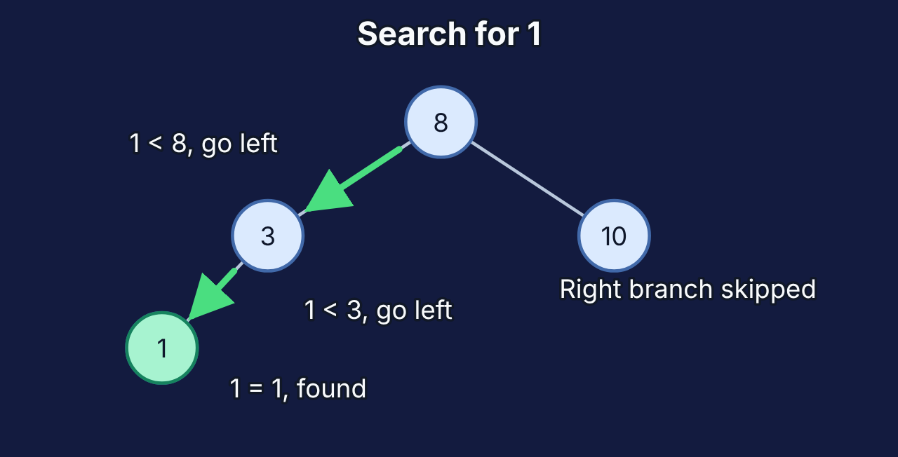
Trees: go left or right at each node
M7
Search for 1
8 → left → 3 → left → 1 (3 checks)
Shape matters
Balanced: about log n checks.
Keys inserted in sorted order: a chain, n checks.
▶ Plays on your next click Repository animation: bst-search.svg
Shaffer (2010, pp. 172, 179)
Mission route
Notes:
Concept (3 min). In a binary search tree (BST), smaller keys go left and larger keys go right of every node.
Search for 1: start at 8 (1 < 8, go left), at 3 (1 < 3, go left), found 1: three checks. Each step skips a whole subtree, like binary search.
Shape matters: a balanced tree of n keys has height about log n; inserting keys in sorted order makes a chain as slow as a linked list (n). Self-balancing trees (AVL) prevent this.
Sources: Shaffer (2010, pp. 172, 179). Study Guide §7.1 "Trees" and §7.4 "Why the shape matters"; Checkpoint 7 (search for 10, then 7, in this tree); Lab 7 "Grow a tree, map a network" (Parts 1–2: insert 6 and 9 into this tree).

Slide 40
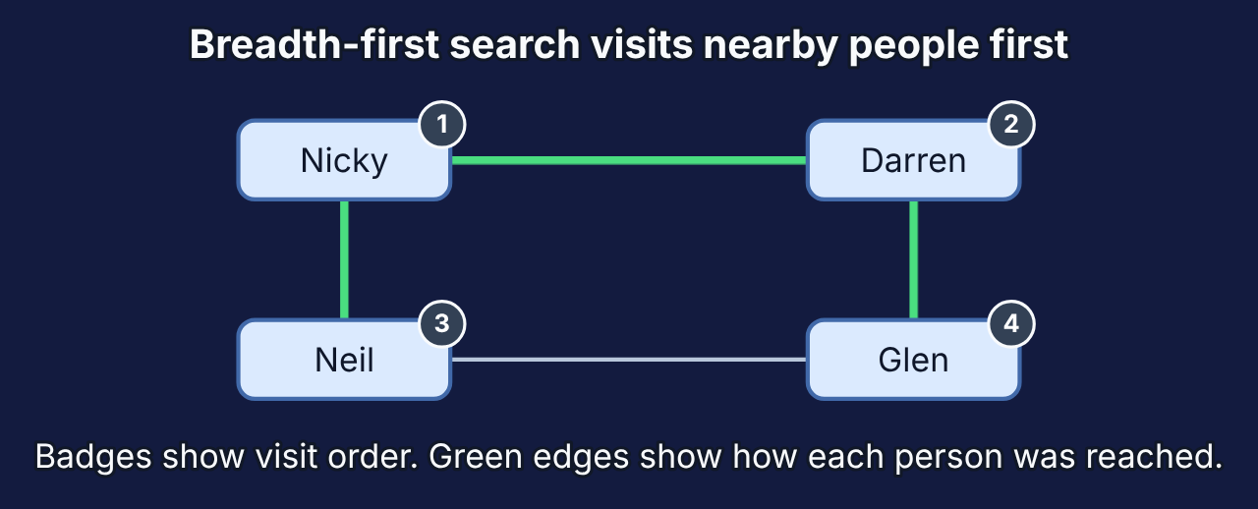
Graphs: who is connected to whom?
M7
Adjacency list
Nicky: Darren, Neil · Glen: Darren, Neil …
▶ Plays on your next click Repository animation: graph-bfs.svg
Adjacency matrix
One cell for every pair: fast lookup, more memory.
Shaffer (2010, p. 391)
Mission route
Notes:
Concept (2 min). A graph is vertices joined by edges. The maze in Part 1 was a graph; so is this friendship network from our Markdown.
Two ways to store it: an adjacency list (each person's friends) or an adjacency matrix (a table with one cell per pair). The matrix answers "are these two friends?" in one look; the list makes it easy to see all of one person's friends and saves memory when people have few friends.
Study Guide Lab 7 Part 3: who can Nicky reach directly (Darren, Neil), and who needs two edges (Glen)? BFS from Nicky: Nicky → Darren → Neil → Glen.
Source: Shaffer (2010, p. 391). Study Guide §7.5 "Graphs" and §7.6 "Storing a graph". Markdown: Content/Markdown/2_Data-Structures/09 graphs.md. Test Bank: A24–A27, B24–B27, C7.

Slide 41
Part 2 recap: store it smart
M7
Match the operation
Array: read by position. List: insert in place.
LIFO and FIFO
Stacks undo and recurse. Queues wait in line.
Branch and connect
Trees halve the search. Graphs store who links to whom.
Next
Study Guide Missions 5–7: Labs 5, 6, 7
Test Bank A18–A27, B16–B27, C4, C6–C7
Markdown notes: Content/Markdown/2_Data-Structures
Mission route
Notes:
Recap and next steps (2 min).
Next steps: Study Guide Missions 5–7: Labs 5, 6, 7; Checkpoints 5, 5B, 6, 6B, 7.
Test Bank: A18–A27, B16–B27, C4, C6–C7.
Markdown: Content/Markdown/2_Data-Structures (chapters 01–09 match Missions 5–7).
Video tutorial "Data Structures⁄Data Versioning.mp4" (Content/Videos) is an extension: dataset versions are not part of the Study Guide or the Test Bank.
Transition: "Everything so far, a person wrote the rules. Next: what if nobody can?"

Slide 42

Part 3 · Connectionist AI
When nobody can write the rules · about 50 minutes in class
8
Teach a neuron
50 min
A28–30 · B28–30 · C8
9
Go deep
35 min
A31–32 · B31–33 · C9
10
Forecast the café
40 min
A33–35 · B34–36 · C10
11
Learn on the fly
40 min
A36–37 · B37–39 · C11
12
Learn from rewards
45 min
A38–40 · B40–42 · C12–13
Study Guide time per mission · Test Bank questions (A true/false, B multiple choice, C open-ended)
Mission route
Notes:
Part 3 takes about 50 minutes: neurons and learning, activations, forecasting, online learning and recommenders, reinforcement learning and checking a model.
Study Guide Missions 8–12. Test Bank: A28–A40, B28–B42, C8–C13.

Slide 43
Write one rule for every handwritten 7
M8
7
7
7
7
One rule that works for all of them?
Suggest a rule · 30 s
Mission route
Notes:
Hook (2 min). The café wants Botak-Bot to read handwritten numbers on order slips.
Ask: "Give me a rule for recognising a 7." People suggest "a horizontal line on top and a diagonal line". Counter-examples: crossed 7s, curved strokes, slanted writing, a 1 with a long top.
Point: nobody can write rules for every handwriting style. Recognising patterns like this is a classic job for neural networks (Snyder, 1996, p. 175).
Transition: "So instead of rules, we give examples, and let the system learn."

Slide 44
Rules or learning?
M8
 | Rules (symbolic AI) | Learning (connectionist AI)
Knowledge | Rules written by people | Weights learned from examples
Good at | Clear facts and conditions | Messy patterns: images, speech
Explaining | Follow the rules | Hard
Example | IF temperature > 38 THEN fever | Reading handwritten digits
Hybrid (neurosymbolic) AI combines both.
Tienson (1987, p. 1); Adorf (1989, p. 216); Snyder (1996, pp. 176, 180)
Mission route
Notes:
Concept (3 min). Rule-based ("symbolic") AI stores explicit facts and rules written by people (Tienson, 1987, p. 1). Connectionist AI is a network of simple units; what it does depends on connection strengths (weights), learned from examples (Adorf, 1989, p. 216; Snyder, 1996, p. 176).
Neither is best for everything: pattern recognition → networks; clear facts and rules → expert systems; both → combine them (Snyder, 1996, p. 180). Example of a hybrid: Kosasih and Brintrup (2025, p. 2268) combine learning with logical rules to predict hidden supply-chain links, matching black-box models on two datasets — one study, not proof that every hybrid is better.
History in one line: McCulloch & Pitts neuron 1943 → perceptron late 1950s → XOR limit 1969 → backpropagation 1980s → deep learning 2012 (Adorf, 1989, pp. 217–218; Goodfellow et al., 2016, ch. 1).

Slide 45
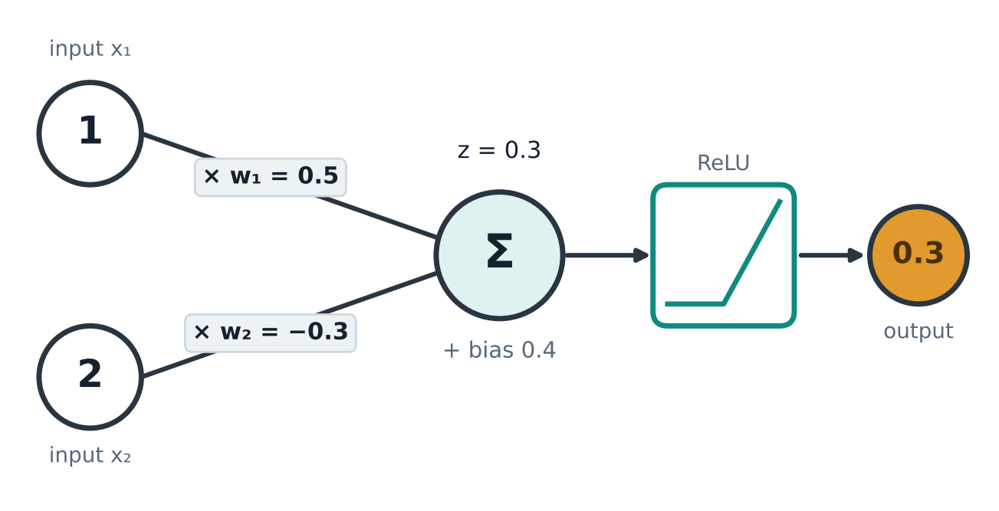
One artificial neuron: multiply, add, activate
M8
1 Multiply
0.5 × 1 = 0.5
−0.3 × 2 = −0.6
2 Add + bias
z = 0.5 − 0.6 + 0.4 = 0.3
3 Activate
ReLU(0.3) = 0.3
Neuron from Content/Markdown/3_Connectionist-AI/02; model as in Adorf (1989, p. 216)
Mission route
Notes:
Worked example (3 min), from Content/Markdown/3_Connectionist-AI/02 (Markdown chapter 2). Inputs [1, 2], weights [0.5, −0.3], bias 0.4.
1 Multiply: 0.5 × 1 = 0.5 and −0.3 × 2 = −0.6. 2 Add with the bias: z = 0.5 − 0.6 + 0.4 = 0.3. 3 Activate: ReLU keeps positive values: output 0.3.
A positive weight pushes the output up, a negative weight pushes it down. The bias shifts the decision point, like b in y = mx + b.
Important limit: artificial neurons are mathematical models chosen for computing, "irrespective of biological fidelity" (Adorf, 1989, p. 216). They are not brain cells.
Study Guide §8.1 "One artificial neuron"; Lab 8A "Paper neuron" Part 1 does the same arithmetic with inputs [2, 1]. Markdown: Content/Markdown/3_Connectionist-AI/02 neural network concepts terminology architectures.md.

Slide 46
Be the neuron: an AND gate
M8
Weights 1 and 1, bias −1.5. Output 1 if the sum > 0.
Input 1 | Input 2 | Sum | Output
0 | 0 | ? | ?
1 | 0 | ? | ?
0 | 1 | ? | ?
1 | 1 | ? | ?
Fill the table · 60 s
Show answer →
Mission route
Notes:
Activity (2 min). Weights [1, 1], bias −1.5. Output 1 if the sum is greater than 0, otherwise 0.
Learners fill the four rows on paper (60 s), then compare with a neighbour.
Expected sums: −1.5, −0.5, −0.5, 0.5 → outputs 0, 0, 0, 1. That is AND.
Answer on the next slide.

Slide 47
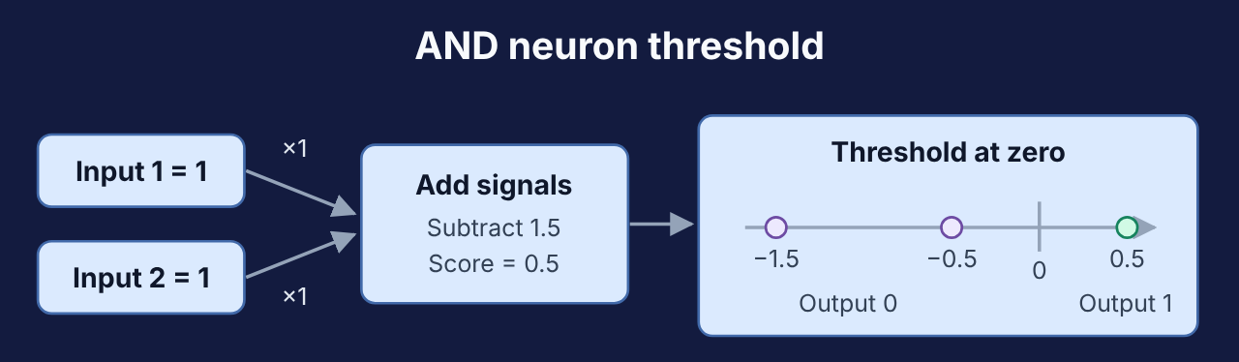
Outputs 0, 0, 0, 1: an AND gate
M8
Input 1
Input 2
Sum = in1 + in2 − 1.5
Output
0
0
−1.5
0
1
0
−0.5
0
0
1
−0.5
0
1
1
0.5
1
Hand-chosen weights: arithmetic, not learning.
▶ Plays on your next click Repository animation: and-neuron.svg
← Back to the question
Mission route
Notes:
Debrief (1 min). Only (1, 1) gives a positive sum (0.5), so only it outputs 1.
We chose these weights by hand: this shows the arithmetic, not learning. A learning algorithm finds weights from examples (two slides on).
Clicks 1–4 reveal one input row at a time (ask the room for each sum first); click 5 plays the neuron animation.
Study Guide §8.2 "A neuron that behaves like a logic gate".
Follow-up question: "Change only the bias to make OR." Answer: any bias between −1 and 0, e.g. −0.5 (Study Guide Lab 8A Part 2). Test Bank A28–A30, B28–B30, C8.

Slide 48
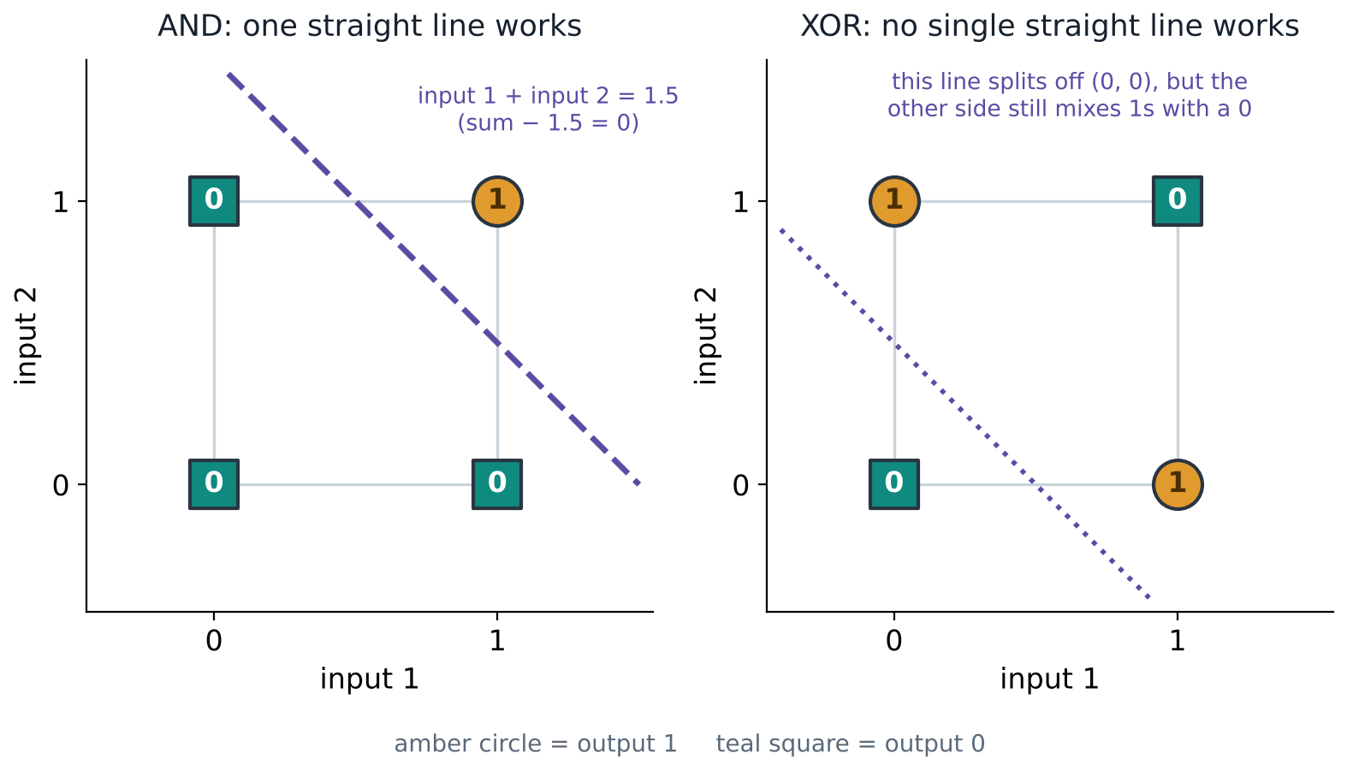
XOR: one straight line is not enough
M8
The fix
A hidden layer: each hidden neuron draws a line, and the output combines them.
Our diagram of the problem described by Adorf (1989, pp. 217–218)
Mission route
Notes:
Concept (3 min). XOR outputs 1 when the inputs differ. Its 1s sit on opposite corners of the square, so no single straight line separates them from the 0s. One neuron draws exactly one straight line, so one neuron cannot do XOR.
History: Minsky and Papert's 1969 analysis of this limit cut interest in perceptrons; multi-layer training later solved XOR (Adorf, 1989, pp. 217–218; Snyder, 1996, p. 179).
Fix: a hidden layer. Each hidden neuron draws a line; the output combines them.
Limit: adding layers lets a network represent more, but does not guarantee it trains well or predicts correctly.
Demonstrate with this diagram: point at the XOR plot and ask a volunteer to draw one line that separates the 1s from the 0s. (Study Guide Lab 8B extends this at home with TensorFlow Playground.)

Slide 49
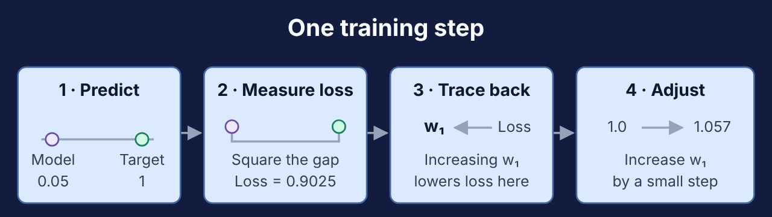
How a network learns: predict, compare, update
M8
Step | Our network
Predict | ŷ = 0.05 (target 1)
Compare | loss = 0.9025
Update | v₁: 1.0 → 1.057
▶ Plays on your next click Repository animation: training-step.svg
Training changes the weights. Prediction uses them, fixed.
Snyder (1996, p. 176); worked network from Content/Markdown/3_Connectionist-AI/02
Mission route
Notes:
Worked step (4 min), our Markdown's 2 → 2 → 1 network with target 1.
Forward pass: prediction ŷ = 0.05. Loss (how wrong): (0.05 − 1)² = 0.9025. Backward pass: the gradient for output weight v₁ is −0.57, so increasing v₁ lowers the loss. Update with learning rate 0.1: v₁ = 1.0 − 0.1 × (−0.57) = 1.057.
Training repeats this for many examples; one pass through all training data is an epoch. After training, weights are held fixed for prediction.
Source: Snyder (1996, p. 176): networks are trained by presenting inputs and outputs. Study Guide §8.4 "How a network learns: one step"; Lab 8A Part 4.

Slide 50
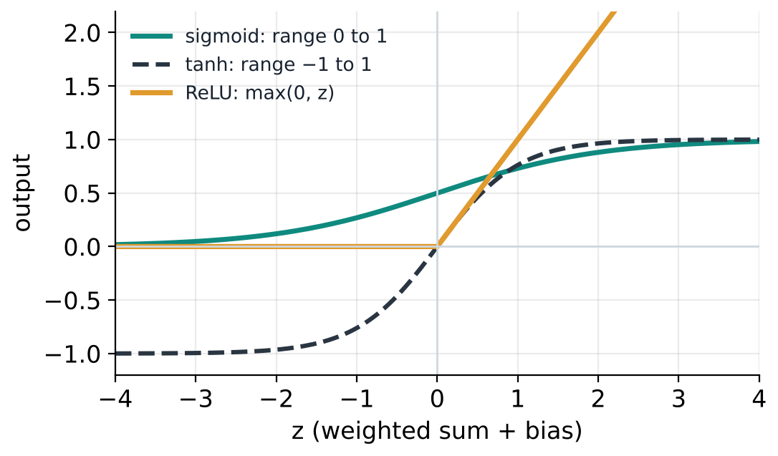
Activations bend the line
M9
z | sigmoid | tanh | ReLU
−2 | 0.119 | −0.964 | 0
0 | 0.500 | 0.000 | 0
2 | 0.881 | 0.964 | 2
No activation: 10 layers still draw one straight line.
Sharma et al. (2020, pp. 310–312); values from Content/Markdown/3_Connectionist-AI/04
Mission route
Notes:
Concept (3 min). Without an activation, each layer computes a straight-line function, and any stack of straight-line layers is still one straight line: it can never learn XOR. A non-linear activation after each layer is what lets extra layers add power (Sharma et al., 2020, pp. 310–311).
Values: sigmoid(−2) = 0.119, sigmoid(0) = 0.5, sigmoid(2) = 0.881; tanh squeezes into −1 to 1; ReLU(z) = max(0, z).
Source check: Sharma et al. (2020, p. 312) misprint the sigmoid formula; the correct one is 1 / (1 + e^(−z)), slope at most 0.25.
Study Guide §9.1 "Why activation functions matter"; Lab 9 "Switch off the activation" (TensorFlow Playground, online; the plot on this slide is the offline fallback).

Slide 51
Pick the output activation
M9
sigmoid · softmax · linear · softplus
A Spam or not spam
B Which digit, 0 to 9?
C A house price
D A forecast’s spread (must be above 0)
Match with a neighbour · 60 s
Show answer →
Mission route
Notes:
Activity (2 min). Options: sigmoid, softmax, linear (none), softplus.
Pairs match each task to one activation in 60 seconds.
Expected: A sigmoid (yes/no probability); B softmax (probabilities over 10 classes adding to 1); C linear (any number); D softplus (must be above 0).
Answer on the next slide.

Slide 52
A sigmoid · B softmax · C linear · D softplus
M9
Task | Output activation | Why
Spam or not | Sigmoid | A probability from 0 to 1
Which digit | Softmax | Probabilities that add up to 1
House price | Linear (none) | Any number
Forecast spread | Softplus | Always above 0
Morozov et al. (2024, p. 149)
← Back to the question
Mission route
Notes:
Debrief (1 min). Softmax turns scores into probabilities adding to 1: scores [2, 1, 0] become about [0.665, 0.245, 0.090] (Morozov et al., 2024, p. 149).
Study Guide §9.2 "Choosing the output activation"; Lab 9 Part 3. Test Bank A31–A32, B31–B33, C9.

Slide 53
98% accurate… and useless?
M9
98%
0 of 400
accuracy when the model always answers “ok”
defects caught (recall = 0)
For rare events, also check recall: the share of real cases the model finds.
Mission route
Notes:
Misconception (2 min). A factory has 20,000 bottle photos; 2% (400) are defective. A model that always says "ok" scores 98% accuracy and catches none of the defects.
Ask: "Would you buy this model?" Then introduce recall: the share of real defects the model finds. Here recall = 0 / 400 = 0.
Study Guide Mission 9, box "Botak-Bot says: accuracy can lie"; Checkpoint 9.

Slide 54
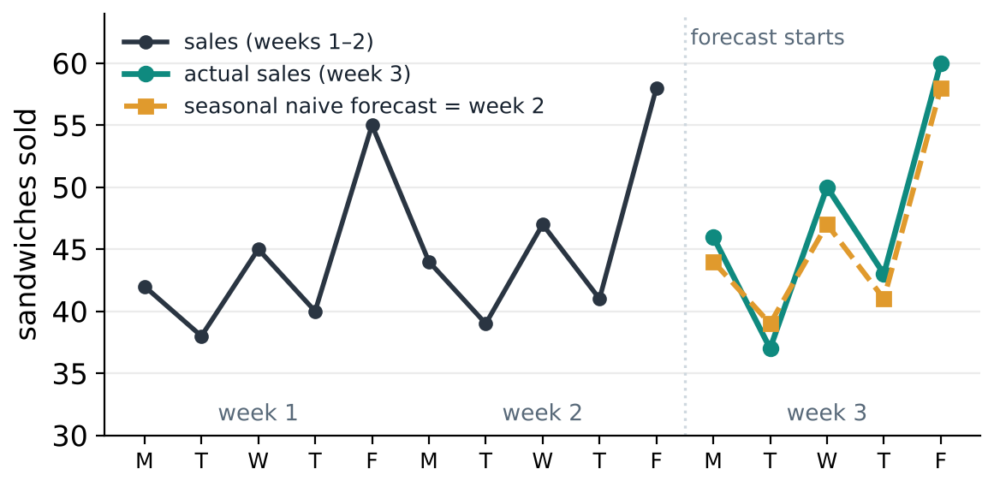
Forecast the café’s sandwiches
M10
Two baselines
Naive: repeat 58 every day
Seasonal naive: copy week 2
Never shuffle time.
Café data made up for the Study Guide; Nguyen (2023, pp. 424–425)
Mission route
Notes:
Context (2 min). Three school weeks of daily sandwich sales. Point out the parts of a time series: level (about 45 a day), seasonality (Friday highest, Tuesday lowest every week), noise.
Rule: split by time — train on the past, test on the future. Never shuffle time (that lets the model peek at later days).
Two simple forecasts for week 3: naive (repeat the last value, 58, every day) and seasonal naive (copy the same weekday from week 2).
Source: Nguyen (2023, pp. 424–425). Study Guide §10.1 "Reading a time series" and §10.3 "Always start with a baseline"; Lab 10 "Botak-Bot's sandwich forecast".

Slide 55
Which forecast wins for week 3?
M10
 | Mon | Tue | Wed | Thu | Fri
Week 2 | 44 | 39 | 47 | 41 | 58
Naive forecast | 58 | 58 | 58 | 58 | 58
Seasonal naive | 44 | 39 | 47 | 41 | 58
Which will be closer to the real week 3?
✗
✓
Naive
Seasonal naive
Tap an answer to check it
Hands up: naive or seasonal? · 20 s
Show answer →
Mission route
Notes:
Activity (1 min). Hands up: naive or seasonal naive?
Week 2: 44, 39, 47, 41, 58. Week 3 actual: 46, 37, 50, 43, 60.
Expected: seasonal naive, because it copies the weekly pattern.

Slide 56
Seasonal naive: average error 2.2 vs 11.6
M10
11.6
MAE, naive
2.2
MAE, seasonal naive
Lab 10 data from the Study Guide; Masini et al. (2021, p. 23)
← Back to the question
Mission route
Notes:
Debrief with chart (2 min). Absolute error = |forecast − actual| per day.
Naive: 12, 21, 8, 15, 2 → MAE = 58 / 5 = 11.6 sandwiches.
Seasonal naive: 2, 2, 3, 2, 2 → MAE = 11 / 5 = 2.2.
A new model is only worth using if it beats a simple baseline like this one. Reviews report that machine learning often helps, but a flexible model can also fit the past too closely and forecast worse (Masini et al., 2021, p. 23).
Study Guide §10.4 "Measuring forecast error"; Lab 10 Parts 1–2. Test Bank A33–A35, B34–B36, C10.

Slide 57
From a forecast to a decision
M10
58
61
Newsvendor rule
Shortage costs 3, leftover costs 1:
stock to 3 ÷ (3 + 1) = 0.75
P50: most likely
P75: what to make
When running out costs more than leftovers, make more than the most likely number.
Haupt et al. (2019, p. 47); Surti & Celani (2019, pp. 325–327)
Mission route
Notes:
Concept (3 min). A probabilistic forecast gives a range: for next Friday, P50 = 58 (half the time demand is below) and P75 = 61.
A sandwich costs 1 to make and sells for 4. Running out loses 4 − 1 = 3 in profit; a leftover wastes 1. Stock to the quantile 3 / (3 + 1) = 0.75: make P75 = 61, not the most likely 58. This is the newsvendor rule.
Why a range: decisions can plan with the best guess and prepare for less likely outcomes (Haupt et al., 2019, p. 47).
Study Guide §10.5 "From one number to a range"; Lab 10 Part 4.

Slide 58
When the world changes, keep learning
M11
Batch
Train once, stay fixed until retrained
Incremental
Update with each new chunk of data
Online
Update after every single example
Concept drift
The pattern changes (a new shop opens), so an old model gets worse. Watch the errors; retrain on recent data.
Pérez-Sánchez et al. (2016, pp. 1–2, 5–6)
Mission route
Notes:
Concept (3 min). A bubble-tea shop opens next door; Friday sales drop. A forecaster trained last month keeps guessing too high: concept drift — the relationship between inputs and target has changed.
Online learning updates the model one example at a time as data arrives, without storing everything. Example: a running mean: new mean = old mean + (new value − old mean) / n.
Ways to adapt: train on a sliding window of recent data, weight recent data more, or retrain when errors rise (Pérez-Sánchez et al., 2016, pp. 2, 5–6).
Limit: there are no standard methods for all changing data streams (Pérez-Sánchez et al., 2016, p. 1), and constant updating can also learn noise.
Study Guide §11.1 "Batch, incremental and online learning" and §11.2 "When the world changes: concept drift"; Checkpoint 11.

Slide 59
Movie night: who has Glen’s taste?
M11
 | Robot Wars | Space Maze | Cake Quest | Byte Club
Nicky | 5 | 4 | 1 | 5
Darren | 1 | 2 | 5 | 1
Neil | 4 | 5 | 2 | 4
Glen | 5 | 5 | 1 | ?
Hands up for a name · 30 s
Show answer →
Mission route
Notes:
Activity (2 min). Ratings from 1 to 5. Glen has not seen Byte Club.
Ask: "Whose ratings look most like Glen's?" Hands up for each name.
Expected: Nicky (very similar), then Neil; Darren is the opposite.
Next slide: cosine similarity confirms it and predicts Glen's rating.

Slide 60
Nicky and Neil match Glen → predict 4.5
M11
0.994
0.981
0.511
cosine similarity with Nicky
cosine similarity with Neil
cosine similarity with Darren
Predict Byte Club for Glen
Average of the two closest: (5 + 4) ÷ 2 = 4.5 → recommend it
Isinkaye et al. (2015, p. 266)
← Back to the question
Mission route
Notes:
Debrief (2 min). Cosine similarity compares rating lists: close to 1 means very similar taste. Using the three films Glen rated:
Nicky 0.994, Neil 0.981, Darren 0.511.
Collaborative filtering: average the two closest users' ratings of Byte Club: (5 + 4) / 2 = 4.5 → recommend it.
Blind spots: cold start (a new user or film has no ratings) and filter bubbles (people only click what they are shown).
Sources: Isinkaye et al. (2015, pp. 266–267). Study Guide §11.3 "Recommendation systems"; Lab 11 "Movie night: be the recommender" Parts 1–2. Test Bank A36–A37, B37–B39, C11.

Slide 61
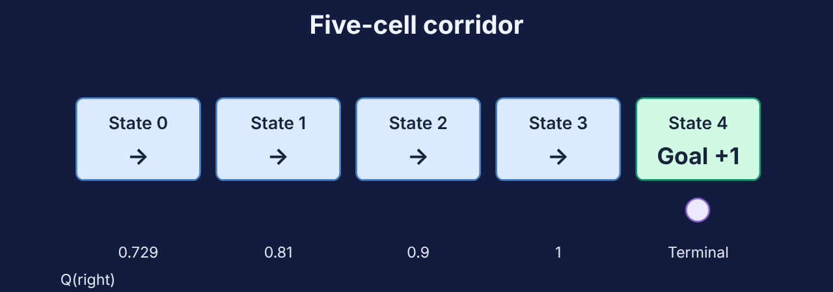
Learning from rewards
M12
▶ Plays on your next click Repository animation: rl-corridor.svg
Agent | Environment | State | Action | Reward
Botak-Bot | The corridor | Its cell | Left or right | +1 at the goal
François-Lavet et al. (2018, pp. 2, 6); Q-values from Content/Markdown/3_Connectionist-AI/09
Mission route
Notes:
Concept (3 min). Botak-Bot in a corridor of five cells; reward +1 only at the goal. Nobody tells it the right move.
Reinforcement learning: an agent takes actions in an environment and learns a policy that earns the most reward (François-Lavet et al., 2018, pp. 2, 6).
Q-learning keeps a table Q(state, action) and nudges it towards reward + discounted best next value. The values in the picture grow towards the goal: 0.73, 0.81, 0.90, 1.00.
Discount γ = 0.9: later rewards count a little less. Explore vs exploit: try new moves sometimes (ε-greedy).
Study Guide §12.1 "Reinforcement learning" and §12.2 "Q-learning"; Lab 12A "Corridor robot". Video tutorial "Reinforcement Learning.mp4" (Content/Videos) shows the corridor robot step by step.

Slide 62
Update one Q-value
M12
new Q = Q + α × (r + γ × best next − Q)
2
Q
0.1
α
0.9
γ
3
r
5
best next
Calculate it · 60 s
Show answer →
Mission route
Notes:
Activity (2 min). Formula: new Q = Q + α × (r + γ × best next − Q).
Values: Q = 2, α = 0.1, γ = 0.9, r = 3, best next value = 5.
Learners calculate in 60 s with a calculator or on paper.
Expected: target 3 + 0.9 × 5 = 7.5; difference 7.5 − 2 = 5.5; new Q = 2 + 0.55 = 2.55.

Slide 63
new Q = 2.55
M12
Target
3 + 0.9 × 5 = 7.5
Gap
7.5 − 2 = 5.5
Step
2 + 0.1 × 5.5 = 2.55
Small steps toward reward + what comes next.
← Back to the question
Mission route
Notes:
Debrief (1 min). Target = 3 + 0.9 × 5 = 7.5. The gap 7.5 − 2 = 5.5 is closed by α = 10%: 2 + 0.1 × 5.5 = 2.55.
γ = 0 would mean the agent only cares about the immediate reward.
Study Guide Checkpoint 12; Lab 12A "Corridor robot". Test Bank A38–A39, B40–B41, C12.

Slide 64
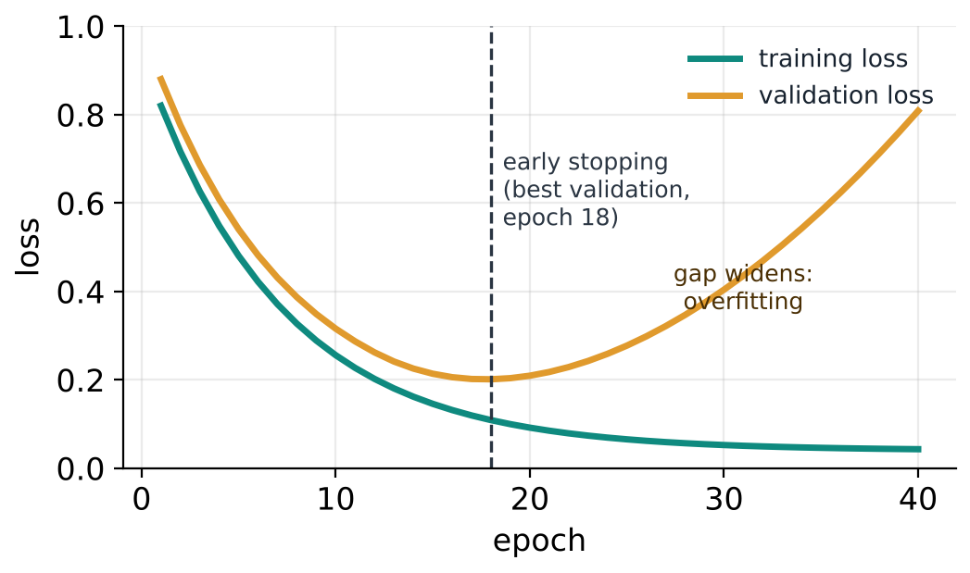
Did it really learn? Check on unseen data
M12
 | Training | Validation
Underfit | High | High
Good fit | Low | Low
Overfit | Very low | High
Before you trust a model
Was it tested on data it never saw?
François-Lavet et al. (2018, pp. 9, 53)
Mission route
Notes:
Concept (3 min). Learning curves: training loss keeps falling, but validation loss starts rising after about epoch 18: the model is memorising (overfitting). Early stopping keeps the version with the best validation loss.
Table: underfitting = both errors high; overfitting = training low, validation high.
Good question to ask of any model: were the test examples kept separate from training, and do they look like the inputs it will really face? "It learned the training examples" and "it will work in the world" are different claims (François-Lavet et al., 2018, p. 53).
Study Guide §12.3 "Training a model well"; Lab 12B "Training doctor". Test Bank A40, B42, C13.

Slide 65
Part 3 recap: learn from examples
M12
Weights learn
Predict, compare, update. Hidden layers + activations bend the line.
Test honestly
Beat a baseline, check recall, test on unseen data.
Data keeps coming
Online learning, recommenders and rewards keep improving.
Next
Study Guide Missions 8–12: Labs 8A–12B
Test Bank A28–A40, B28–B42, C8–C13
Video tutorial: Reinforcement Learning
Markdown notes: Content/Markdown/3_Connectionist-AI
Mission route
Notes:
Recap and next steps (2 min).
Next steps: Study Guide Missions 8–12: Labs 8A, 8B, 9, 10, 11, 12A, 12B; Checkpoints 8–12.
Test Bank: A28–A40, B28–B42, C8–C13.
Markdown: Content/Markdown/3_Connectionist-AI (chapters 01–10 match Missions 8–12).
Video tutorial "Reinforcement Learning.mp4" (Content/Videos) replays the Mission 12 corridor robot.
Transition: "Now all three parts work together: the final mission."

Slide 66

Final mission · Putting it together
Which tools fit which job? · about 10 minutes in class
F
Which tools fit which job?
20 min
Lab 13
Study Guide time per mission · Test Bank questions (A true/false, B multiple choice, C open-ended)
Mission route
Notes:
Final mission (about 10 minutes, plus a few minutes of closing slides), following the Study Guide's final mission "Putting it together" (core question: which tools fit which job?).
Data structures decide how information is stored, algorithms decide how it is processed, and connectionist AI learns the rules from data when nobody can write them by hand. The final activity is Study Guide Lab 13, "Botak-Bot's job interview".
The final mission has no Test Bank questions of its own: it ends with "Next stop: Test Bank V1.0" (40 true/false, 42 multiple choice, 13 open-ended).

Slide 67
Three areas, one toolkit
F
Algorithms: how it is processed
Data structures: how it is stored
Connectionist AI: learns the rules
Situation | Tool
Robot vacuum: shortest route to its charger | BFS on a grid graph, with a queue
Delivery app: cheapest route | Dijkstra with a priority queue
Undo button | A stack of previous states
Leaderboard: one new score | Insertion sort on a sorted array
Café: how many sandwiches? | Seasonal naive, then a neural forecaster + P75 rule
Streaming app: next video to suggest | Embeddings (matrix factorisation), updated online
Mission route
Notes:
Synthesis — save the best for last (3 min). This is the Study Guide's final-mission table (Fig. F.1 "Three areas, one toolkit" and the situation table). The slide shows the situation and the tool; the guide's third column, the areas each row combines, is in brackets below for you to say aloud.
Walk down the rows and ask for each one: "Which part of today does this use?"
Robot vacuum → BFS on a grid graph, using a queue (algorithm + graph + queue). Delivery app → Dijkstra's algorithm with a priority queue (greedy algorithm + weighted graph). Undo button → a stack of previous states (data structure). Leaderboard gets one new score → insertion sort on an already-sorted array (algorithm + array). Café sandwiches → seasonal naive baseline, then a neural forecaster with a P75 stocking rule (connectionist AI + decision rule). Streaming app → embeddings learned by matrix factorisation, updated online (connectionist AI + online learning).
Point out the link the guide makes: training a neural network is itself an algorithm (gradient descent), and it stores its weights and training data in arrays.
Resolve the opening: at the start Botak-Bot could not even "find the highest score" without steps. Now it has steps (algorithms), memory (data structures) and learning (connectionist AI).

Slide 68
Botak-Bot’s job interview
F
(a) A printer serving jobs in arrival order
(b) Does a username exist in a sorted list of 1,000,000 names?
(c) The route with the fewest stops between two stations
(d) Put one new score into a sorted class list of 30 scores
(e) Read handwritten digits on order slips
(f) A game character that learns to win by playing many times
Choose a tool for each · 2 min
Show answer →
Mission route
Notes:
Final activity (4 min), Study Guide Lab 13 "Botak-Bot's job interview". For each job, pairs choose a data structure, algorithm or learning method and give one reason. Then call out answers job by job (hands up for each option you hear).
Expected (next slide): (a) queue; (b) binary search; (c) BFS; (d) insertion sort; (e) neural network; (f) reinforcement learning.
Reflection question from the lab: which jobs have a rule you could write by hand, and which need learning from data?

Slide 69
One tool for each job
F
Job | Tool | Why
(a) Printer jobs | Queue | First in, first out
(b) Sorted usernames | Binary search | About 20 checks
(c) Fewest stops | BFS | Explores in waves
(d) One new score | Insertion sort | At most 59 comparisons
(e) Handwriting | Neural network | No writable rule
(f) Game character | Reinforcement learning | Learns from rewards
← Back to the question
Mission route
Notes:
Debrief (3 min), Lab 13 feedback.
(a) Queue: first in, first out. (b) Binary search: about 20 checks instead of up to 1,000,000. (c) BFS on a graph of stations: each stop counts as one step, so the first route found has the fewest stops. (d) Insertion sort: the 30 old scores are already in order, so passing over them takes only 29 comparisons, and the new score moves left only past the bigger scores (at most 30 more): at most 59 comparisons. Selection sort would always make 31 × 30 ÷ 2 = 465. (e) A neural network trained on labelled examples, with a softmax output for the ten digits: nobody can write rules for every handwriting style. (f) Reinforcement learning: the character learns from the reward for winning, by trial and error.
Big idea: jobs (a)–(d) have exact rules, so classic algorithms and data structures solve them reliably; jobs (e) and (f) have no rule anyone can write down, but there are many examples or trials to learn from.
Next stop, as in the Study Guide: Test Bank V1.0.

Slide 70
Three things to remember
★
1
Algorithms
Precise steps, and Big-O tells you how the work grows.
2
Data structures
Store data to suit the operation you do most.
3
Connectionist AI
When nobody can write the rules, learn from examples — and test honestly.
Mission route
Notes:
Takeaways (1 min). Read them slowly; they are the three parts in one sentence each.

Slide 71
Where to practise next
★
Learning resources from the Study Guide
Study Guide V1.0
13 missions · labs · checkpoints
Sorting folk dances
AlgoRythmics · Mission 2
Test Bank V1.0
95 questions: 40 A · 42 B · 13 C
VisuAlgo
Sorting, graph traversal · Missions 2, 4
Markdown Content V2.0
Content/Markdown in our repository
TensorFlow Playground
Missions 8, 9 (Lab 8B, Lab 9)
Video tutorials
Reinforcement Learning + 2 extensions
“But what is a neural network?”
3Blue1Brown · Mission 8
Mission route
Notes:
Next steps (1 min). Show where everything is.
Study Guide V1.0 (Robot Edition, interactive PDF): 13 missions (Missions 1–12 and the final mission) with labs, checkpoints, a summary sheet and a glossary.
Test Bank V1.0: 40 true/false (A1–A40), 42 multiple choice (B1–B42) and 13 open-ended (C1–C13) questions, each labelled with its mission, with an answer key.
Markdown Content V2.0: Content/Markdown in the GitHub repository, the source of every example in these slides.
Video tutorials (Content/Videos): "Reinforcement Learning.mp4" (Mission 12), and two extensions beyond the Study Guide: "Sequential Decisions.mp4" and "Data Structures⁄Data Versioning.mp4".
The four learning resources on the right are the ones the Study Guide itself lists, with the missions that use them. They need internet; every slide in this deck works without them.

Slide 72
Sources: algorithms and data structures
★
Chivers, I., & Sleightholme, J. (2018). An introduction to algorithms and the Big O notation. In Introduction to Programming with Fortran (ch. 23). Springer. https://doi.org/10.1007/978-3-319-75502-1_23
Dijkstra, E. W. (1959). A note on two problems in connexion with graphs. Numerische Mathematik, 1, 269–271. https://doi.org/10.1007/BF01386390
Hill, R. K. (2016). What an algorithm is. Philosophy & Technology, 29(1), 35–59. https://doi.org/10.1007/s13347-014-0184-5
Shaffer, C. A. (2010). A Practical Introduction to Data Structures and Algorithm Analysis (3rd ed., Java version). Virginia Tech.
Diagrams, examples, data and Botak-Bot: Team B.O.T.A.K.
Mission route
Notes:
References for the facts and page numbers quoted on the slides and in the notes of Parts 1 and 2. The Study Guide's own "Resources and references" page lists Hill (2016), Dijkstra (1959), Goodfellow et al. (2016), Hyndman & Athanasopoulos (2021), Sutton & Barto (2018) and Smilkov et al. (2017); the other sources here are the ones these slides quote directly.
All diagrams, examples, the café data and the Botak-Bot mascot were made by Team B.O.T.A.K.; the examples come from our Markdown Content (Content/Markdown). AI assistance used in preparing these slides is recorded in the project and personal logs.

Slide 73
Sources: connectionist AI
★
Adorf, H.-M. (1989). Connectionism and neural networks. In Knowledge-Based Systems in Astronomy (pp. 213–245). Springer.
François-Lavet, V., et al. (2018). An introduction to deep reinforcement learning. Foundations and Trends in Machine Learning, 11(3–4).
Goodfellow, I., Bengio, Y., & Courville, A. (2016). Deep Learning. MIT Press.
Haupt, S. E., et al. (2019). The use of probabilistic forecasts. IEEE Power and Energy Magazine, 17(6), 46–57.
Isinkaye, F. O., et al. (2015). Recommendation systems: Principles, methods and evaluation. Egyptian Informatics Journal, 16, 261–273.
Kosasih, E. E., & Brintrup, A. (2025). Towards trustworthy AI for link prediction in supply chain knowledge graph. Int. J. of Production Research, 63(6), 2268–2290.
Masini, R. P., et al. (2021). Machine learning advances for time series forecasting. arXiv:2012.12802.
Morozov, A. V., et al. (2024). Activation functions in neural networks: Overview and comparison. Sci. Notes of Taurida National University, 35(74), 144–151.
Nguyen, T. T. H. (2023). Applications of artificial intelligence for demand forecasting. Operations and Supply Chain Management, 16(4), 424–434.
Pérez-Sánchez, B., et al. (2016). A review of adaptive online learning for artificial neural networks. Artificial Intelligence Review.
Sharma, S., et al. (2020). Activation functions in neural networks. Int. J. of Engineering Applied Sciences and Technology, 4(12), 310–316.
Snyder, R. M. (1996). Neural networks for the beginner. ASCUE Summer Conference Proceedings, 174–180.
Surti, C., & Celani, A. (2019). Newsvendor game. Decision Sciences Journal of Innovative Education, 17(4).
Sutton, R. S., & Barto, A. G. (2018). Reinforcement Learning: An Introduction (2nd ed.). MIT Press.
Tienson, J. L. (1987). An introduction to connectionism. The Southern Journal of Philosophy, 26 (Supplement).
Mission route
Notes:
References for the facts and page numbers quoted on the slides and in the notes of Part 3.

